Slide 1
And
Social Care
Because Safeguarding is everybody’s business

Slide 2
Worcestershire Safeguarding Adults Board
Network Meeting
5th July 2023
Because Safeguarding is everybody’s business

Slide 3
Why are we here
REFLECT
and
LEARN
Respect Each others' views and positions
Because Safeguarding is everybody’s business

Slide 4
AGENDA
10:00 | Welcome and Introductions
10:15 | Guest Presentation – Loan Sharks
11:15 | Break
11:30 | Exploitation Strategy – consultation
11:50 | Actions From last Time
12:00 | SARs
12:20 | Future agenda items
Because Safeguarding is everybody’s business
Notes:
What is it that makes us keep doing what we do ?

Slide 5
Guest Presentation
Nadeem Mahammed
Loan Sharks
Because Safeguarding is everybody’s business
Notes:
What is it that makes us keep doing what we do ?

Slide 6
Draft Strategy Consultation Link to Draft Strategy and Questionnaire
Adult Exploitation in Worcestershire

Slide 7
What have we currently got?
Definition
National Statutory Guidance on some areas (e.g Modern Slavery)
Other Areas policies/procedures/strategies
Local Forums and Meetings
Care Act Section 42
Funding to take forward
(WSAB, Public Health and SW Community safety Partnership)
Letter from West Midlands PCC office
Children's response

Slide 8
Going Well | Areas for Improvement | Barriers for Victims | Training Needs
New Passion | Understanding specialist areas | Lack of resources for services | More training for first responders
Today is an opportunity | Identification | Awareness | Pathway
 | Improved link between child and adult | Professionals do not have time | Organisational training
 | Access to work, training, accommodation | Victims not aware of services | Raise public awareness
 | Needmore accommodation esp. Pre NRM | Stigma | Understanding local and regional services and what they do.
 | More prosecution of perps and OCG | Gap between reporting crime and action taken
 | Holistic support
Feedback from Third Sector Focus Group

Slide 9
Stakeholder Day
Identified what organisations currently had in place and how they manage Adult Exploitation Cases
Had a presentation on CARM process as a possible vehicle for managing non s42 cases
Started to build the strategy as follows……..

Slide 10
Vision
Mission
Objectives
Strategy
Approach

Slide 11
Key Considerations
How to we know the size of the issue?
Where will Governance and accountability lie?
Where are the links with other strategies
How will we monitor success?
Notes:
After group work, attendees very much wanted to mirror the Children's response- it works well and people are used to it

Slide 12
Data- How big is the issue in Worcestershire ?
Some national data available
Local data sketchy and patchy
Likely to be underreporting
Without a collaborative pathway and process, data gathering is ad hoc

Slide 13
Prepare
Prevent
Pursue
Protect
Tackling the 4P’s
Groupwork led to identified elements of the strategy under 4 headings

Slide 14
PREPARE
All agencies will understand the forms of Adult Exploitation across the county and the challenges faced by adults who are vulnerable and that the outputs from this work can be measured, and reviewed.
PREVENT
Increase awareness and understanding of adults at risk, professionals and public of community risks and threats, thereby increasing prevention and resilience.
PROTECT
All agencies are steadfast in their protection of those adults who are at risk of or victims of all types of exploitation.
Partner agencies will work together to ensure that exploited adults are heard, protected and that offenders will be held to account.
PURSUE
All agencies will work together to prosecute the crimes of exploitation and disrupt individuals and groups responsible for perpetrating exploitation of adults.
Agencies will collaborate effectively across enforcement services to utilise all forms of legal enforcement routes to minimise the ability to exploit adults and bring to prosecution where necessary.
Ensure effective intelligence sharing across organisations related to places where exploitation occurs and those who perpetrate exploitation.
Develop and share offender profiles to enable an understanding of the processes that perpetrators take to enable effective disruption.
Provide clear governance and accountability.
Develop an understanding of the profile of victims and offenders in the County.
Develop and strengthen data gathering.
Use intelligence and information sharing to keep up with how exploitation is changing over time in order that processes remain relevant.
Offer training and other awareness raising options across all agencies that increases the early identification of those at risk.
Support a communication strategy that covers a range of audiences and includes campaign materials and resources.
Provide tools and guidance that support identifications, types of exploitation.
All agencies will commit to ensuring that relevant guidance, procedures, and pathways are in place and complied with.
All agencies will identify a key lead for Adult Exploitation where appropriate.
Safety planning will be effective and creative.
Agencies will intervene to protect victims and those at risk at an early stage to limit the impact of abuse and exploitation

Slide 15
Next Steps
Document circulated with feedback questionnaire
Link to Draft Strategy and Questionnaire
Wider consultation event (held 21st June) – Has helped to
Identify more sources of data
Begin to understand some of the current responses and pathways
Highlight issues in current situation
Explore how different agencies can support delivery
WSAB engaged in more meetings
Task and Finish Group to work on resultant Action Plan

Slide 16
What we would like to know (via questionnaire)
Does this strategy present any gaps or challenges that we need to consider?
Is the Strategy Vision clear?
Consider the aims and tasks under each of the four objectives – are there more? Are there crossovers?
Please comment on the proposed governance for the strategy
IMPORTANT
Which objectives will your organisation be able to support
Note any additional comments

Slide 17
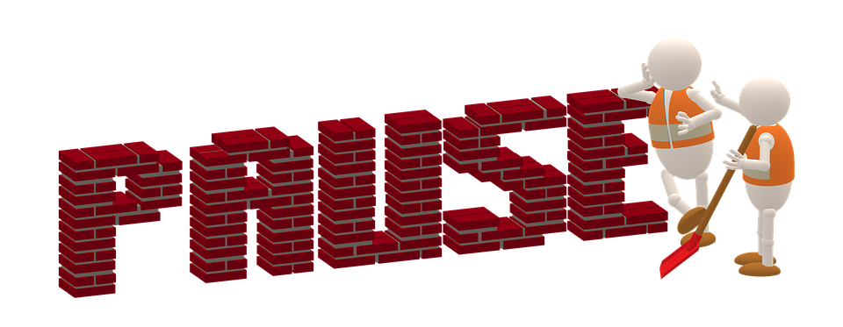
Comfort Break
Because Safeguarding is everybody’s business
Notes:
What is it that makes us keep doing what we do ?

Slide 18
Actions from last meeting | Status
Share DBS Presentation and information with network | Completed
Network members share details of good practice with WSAB on training and support they provide for volunteers and PWLE | Ongoing
Share feedback from item on developing collaborative work with PWLE and Experts by experience with Board. Including: How appropriate organisation's with can engage earlier in SAR process Looking at champion model Consider how representatives from the network can have more of an active part in strategy day/development Network members provide small bio of their work and role in safeguarding | Report shared with Board, Exploring ways to take this forward Update at future meeting
If anyone has work they are proud of and happy to share with the Board we will look at publishing in Annual Report | Ongoing )
Provide information on which organisations made SAR referrals over last 3 years. | Provided today
Topics for future meetings Mental Capacity Act CQC LA inspection how will it impact services Transitional safeguarding
Because Safeguarding is everybody’s business
Notes:
What is it that makes us keep doing what we do ?

Slide 19
SARs Singed off since last meeting Ruth
Ruth was a 49-year-old, white British female
Ruth had complex health conditions and was required to take multiple medications
Referrals were made to agencies regarding Ruth’s physical and mental health needs and poor living conditions.
Ruth was clearly loved by her family. There was limited contact prior to her death
Ruth had a long-standing intimate relationship with Simon.
Since 2015 Ruth had raised concerns with agencies around sexual, physical and financial abuse by Simon
Ruth also described Simon as a friend and stated she relied on his help.
Simon was paid carer’s allowance
There were concerns that Ruth was the subject of coercive control by Simon
Because Safeguarding is everybody’s business
Notes:
What is it that makes us keep doing what we do ?

Slide 20
Ruth Care Support and Treatment
Ruth was know to several agencies
Ruth’s contact with agencies and professionals reduced over time.
Agencies appear to be operating in isolation with an absence of a multi-agency approach to Ruth’s complex needs
Because Safeguarding is everybody’s business
Notes:
What is it that makes us keep doing what we do ?

Slide 21
Ruth Circumstances leading to Death
NHS 111 received a call from Simon stating that Ruth was not eating and feeling unwell. Simon said he thought that she was dying, and she could be heard groaning in the background
An ambulance crew attended and found Ruth deceased
Simon informed the crew that she had suffered a fit and taken morphine
The ambulance crew observed that Ruth was wearing a soiled pad which appeared several days old. There was a wound under the pad which gave off a ‘pungent smell of decay’
Ruth appeared to have been well fed and hydrated
Ruth’s flat was noted to be untidy and unclean
Because Safeguarding is everybody’s business
Notes:
What is it that makes us keep doing what we do ?

Slide 22
Ruth Good Practice Identified
Professionals adopted a caring and supportive approach
At times there was evidence of listening and responding to Ruth’s wishes
At times, information was shared to highlight risk
At times, referrals to other agencies were made
At times, support was provided
DASH risk assessments were completed, and Risk Management Plans were put in place
Witness interviews were obtained in the presence of appropriate adults and were carried out under Achieving Best Evidence processes
Simon was formally interviewed regarding the allegations of physical and sexual abuse
All agencies demonstrated an openness and willingness to learn during the review
Because Safeguarding is everybody’s business
Notes:
What is it that makes us keep doing what we do ?

Slide 23
Ruth Continuous Improvement Since Death
It is acknowledged that since RUTH passed away:
WSAB have continued to promote professional curiosity with all agencies.
WSAB have adopted the refreshed Self Neglect Policy and Complex Adults Risk Management (CARM) Framework.
The Domestic Abuse Partnership Board have continued to promote professional development around domestic abuse with all agencies.
Because Safeguarding is everybody’s business
Notes:
What is it that makes us keep doing what we do ?

Slide 24
Ruth What needs to be done further
Mullti-agency Working | All professionals should familiarise themselves with the WSAB Complex Adult Risk Management (CARM) framework
Making Safeguarding Personal | It is important that professionals seek to engage with people so that they can gain a clearer picture of the situation and better understand their needs, wishes, beliefs, priorities, and motivations They should also be professionally curious, particularly where the vulnerable person may be reluctant to engage. They should ensure that there is clear consent, and the carer is acting in the person’s best interests. This will facilitate more robust and comprehensive assessments
Self Neglect | Professionals should: Understand the importance of assessing the risk posed by people who elect to adopt a ‘carer’s’ role. Understand The importance of taking robust action, and looking at the cumulative picture, when abuse is alleged. Receive support and education on identifying coercive and controlling behaviour, including finding safe spaces to talk to people they suspect may be being abused, so they are better able to identify unsafe relationships. familiarise themselves with the WSAB Self-Neglect and Hoarding Policy
Because Safeguarding is everybody’s business
Notes:
What is it that makes us keep doing what we do ?

Slide 25
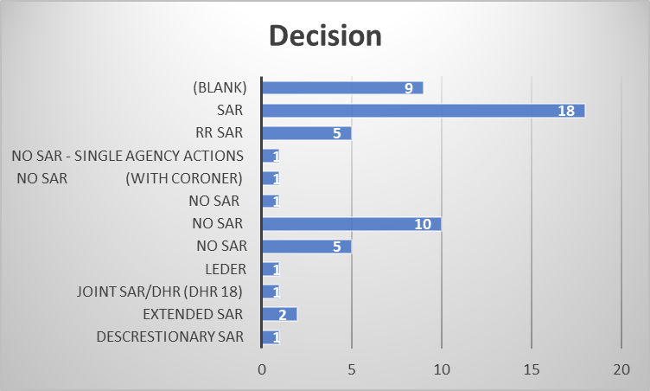
SARs Referrals and Outcomes Since April 2016 to June 2023 55 Referrals Blank = Decision Pending
Because Safeguarding is everybody’s business
Notes:
What is it that makes us keep doing what we do ?

Slide 26
SARs Referrals from
Because Safeguarding is everybody’s business
Notes:
What is it that makes us keep doing what we do ?

Slide 27
Of those that went to Review SAR/Discretionary SAR/Extended SAR/ Rapid Review/LeDeR/ Domestic Homicide Review
Because Safeguarding is everybody’s business
Notes:
What is it that makes us keep doing what we do ?

Slide 28
Future Meeting Items
Future presentations?
Mental Capacity Act
CARM Update (following Survey)
Self-Neglect Policy (Following survey)
CQC LA inspection how will it impact services
Transitional safeguarding
Anything from today
Because Safeguarding is everybody’s business
Notes:
What is it that makes us keep doing what we do ?

Slide 29
Close and Network Thank you
Because Safeguarding is everybody’s business
Notes:
What is it that makes us keep doing what we do ?

