Slide 1
Second National Analysis of SARs

Slide 4
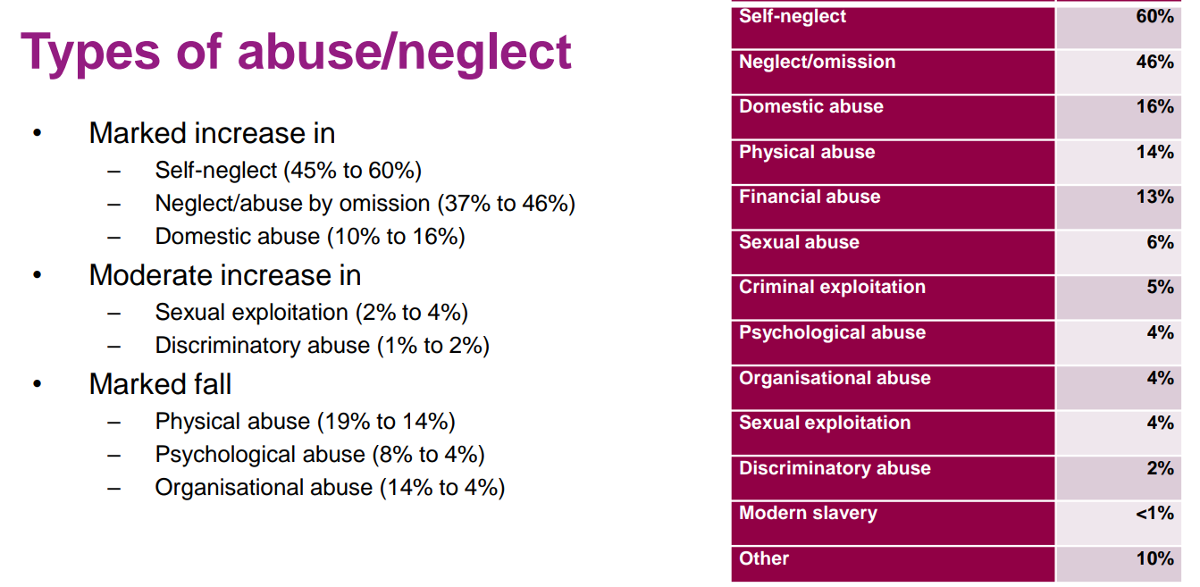

Slide 5
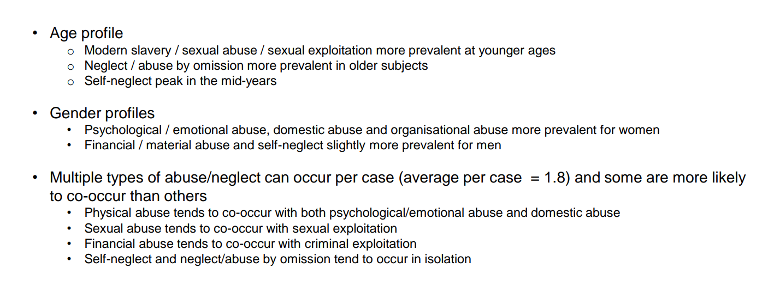

Slide 6
Learning from SARs

Slide 7
Good practice across the domains

Slide 8
Good practice themes

Slide 9
Practice shortcomings across the domains

Slide 10
Shortcomings: key themes

Slide 11
National legal, policy and financial context

Slide 12
Recommendations made by SARs

Slide 13
Improvement priorities

Slide 14
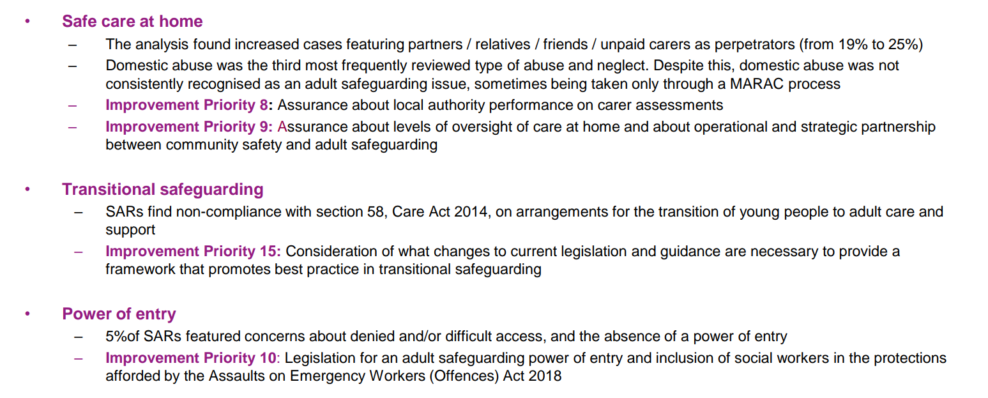

Slide 15
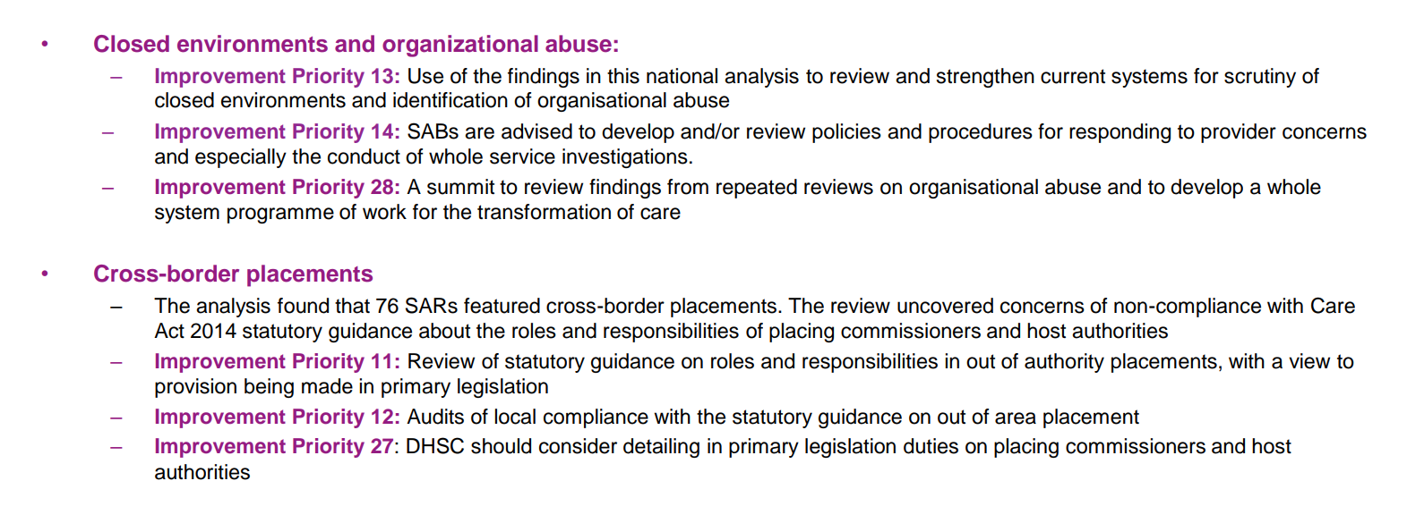

Slide 16
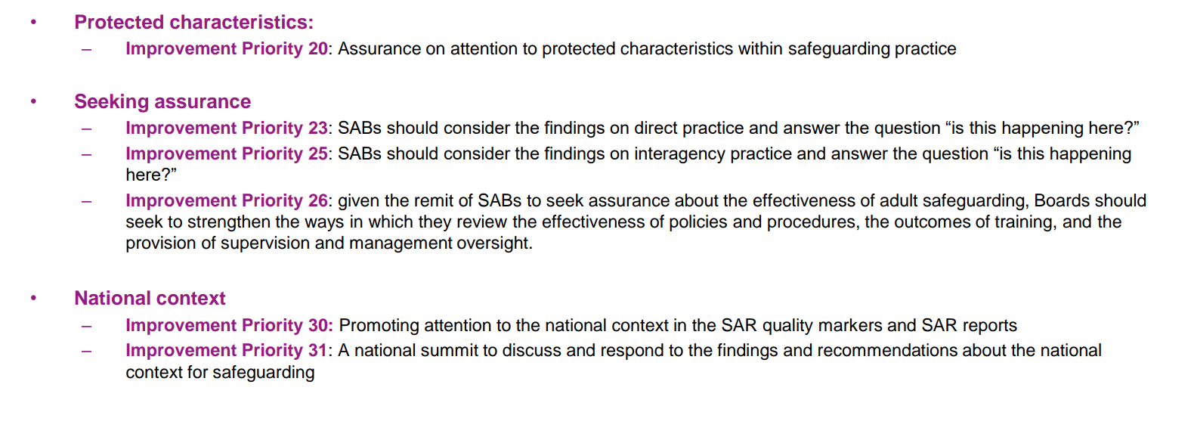

Slide 17
Findings on SARs themselves

Slide 18
Improving the SAR process

Slide 19
Improvement priorities for SAR processes

Slide 20
Some priorities for SAR quality assurance

